Slide 1

RTR
SOFTWARE
Unlocking the Full Potential of SATEC Meters in Energy Projects
ATHENS SATEC Partners Conference 2026
Presenter: Andrey Sokolik

Slide 2





Why Energy Projects are Different?
High dynamics
Grid complexity
Strict compliance requirements
Need for high-resolution metering data
Renewable projects demand more from meters and software

Slide 3


The Challenge with SCADA & Meter Integration?
SCADA developers often:
Aim to achieve Modbus optimisation
Poll too slowly to utilise meter capabilities
Do not fully use SATEC fast communication
Result:
Lost data resolution
Reduced project performance
Under-used meter functionality

Slide 4
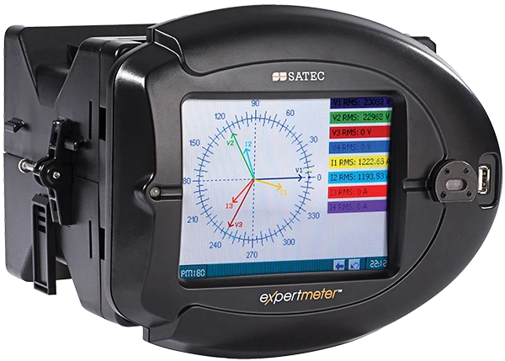
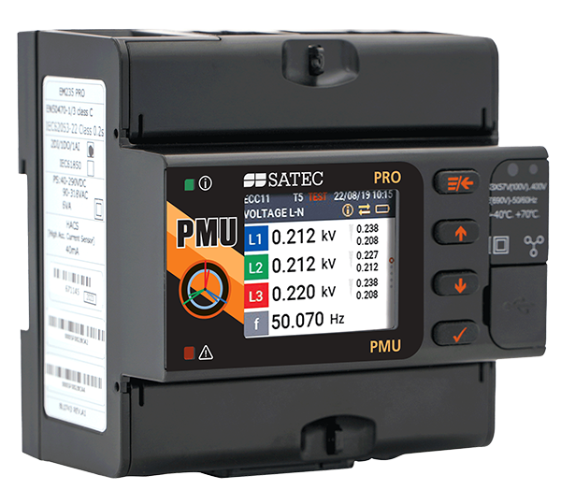

Why This Impacts SATEC Meter Sales?
SATEC meters are powerful and fast
Benefits are not always realised on site
Developers may select “simpler” meters
Software layer becomes
the key differentiator

Slide 5

Introducing RTR Software
High-performance Modbus middleware
Positioned between:
SATEC meters / other devices
SCADA systems / APIs / Databases
Designed for energy applications

Slide 6

RTR Architecture Overview
MODBUS POLLING ENGINE
DATA PROCESSING
LAYER
OUTPUT FORMATS
DATA DELIVERY
CSV
JSON
COMTRADE
Database
Local Storage
FTP / SFTP
API Integration
SQL / NoSQL
Modbus TCP over ETH
Modbus RTU over RS-485 / USB
(USB currently Linux driver only)
RTR removes communication and data-handling complexity
from SCADA systems

Slide 7

RTR Software – Key Advantages

Slide 8
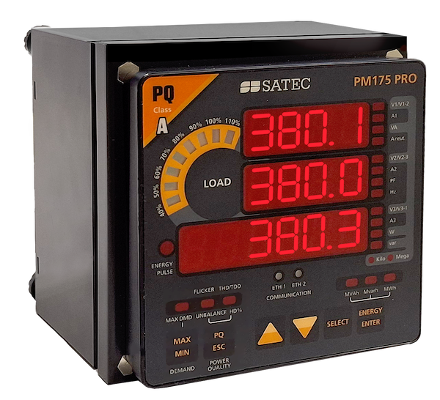
#1: Ultra-Fast Polling
Guaranteed reading rates:
10 ms – PRO meters over Ethernet
20 ms – PM180
Can interrogate several devices
Can use simultaneously
5 Ethernet sockets (connections) on each ETH port
1 RS-485 connection
Enables:
Fast frequency response services
Event-based and continuous recording
High-resolution analytics

Slide 9




#2: Cross-Platform & Flexible
Compiles for:
Windows
Linux
Supports multiple CPU architectures:
x86 32bit / 64 bit
ARM 32bit / 64 bit

Slide 10
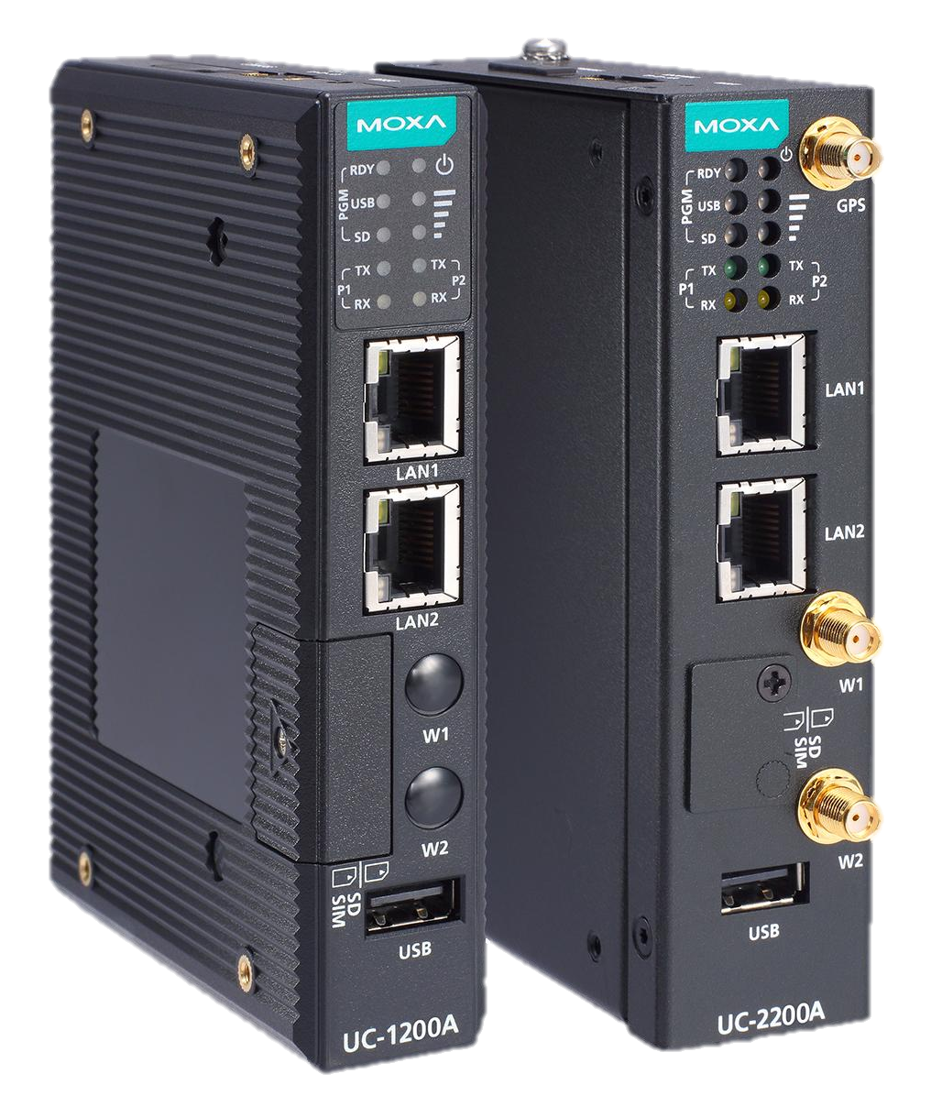
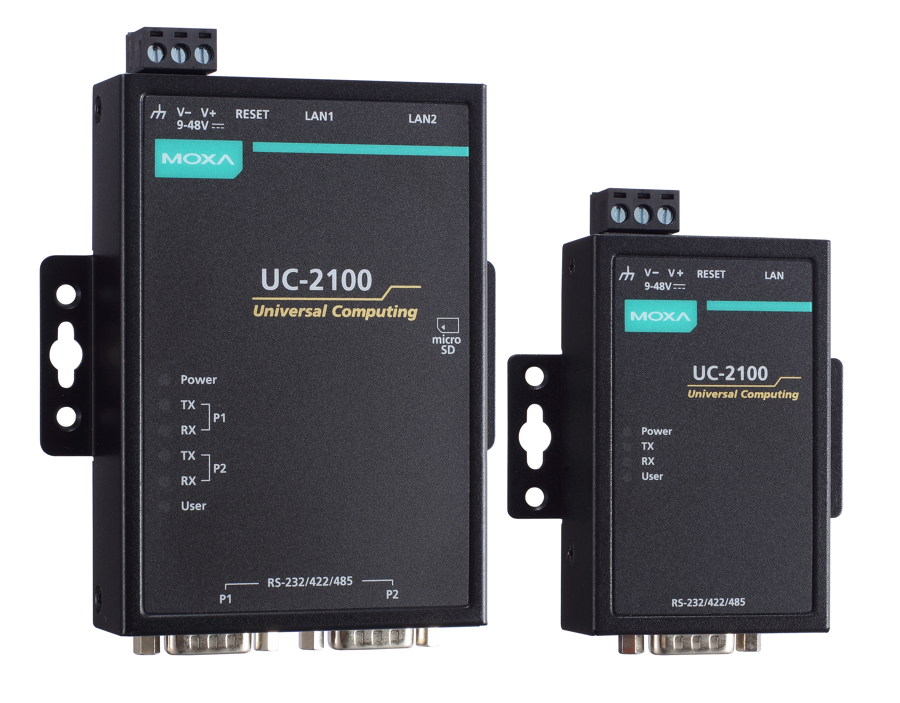
#3: Lightweight, Stable & Reliable
Very low CPU and RAM usage
Runs on compact embedded hardware
Proven on platforms such as:
MOXA UC-2101-LX
600 MHz CPU
1 × LAN, 1 × Serial
Stable operation
No memory leaks
Can run for years without reboot

Slide 11
#4: Flexibility & Advanced Logic
Email notifications
Error logging:
Clock synchronisation issues
Connectivity issues
I/O issues
Calculation of derived parameters
Not limited to 64 meter set-points
Can control multiple devices via Modbus and other protocols

Slide 12
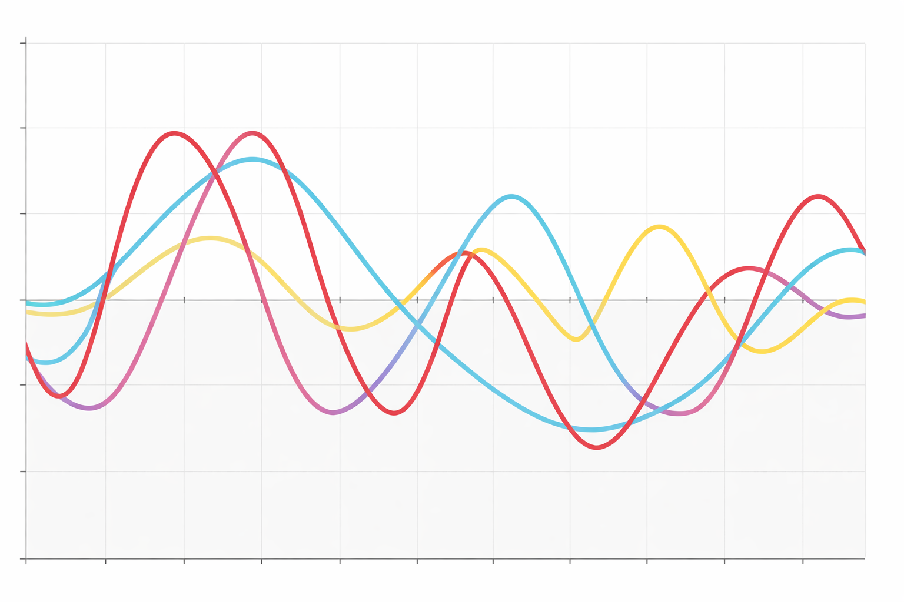
#5: Continuous data & waveform recording
Frequent data logging shortens meter memory life
RTR supports:
Continuous high-frequency data logs without using meter memory
Continuous waveform recording 128 samples per cycle / 6 channels

Slide 13

#6: Modular RTR Library Concept
RTR is built from reusable software
components / blocks to build multiple solutions
This enables:
Customised solutions
Fast project delivery
Easy integration for new applications

Slide 14
RTR Software Applications

Slide 15
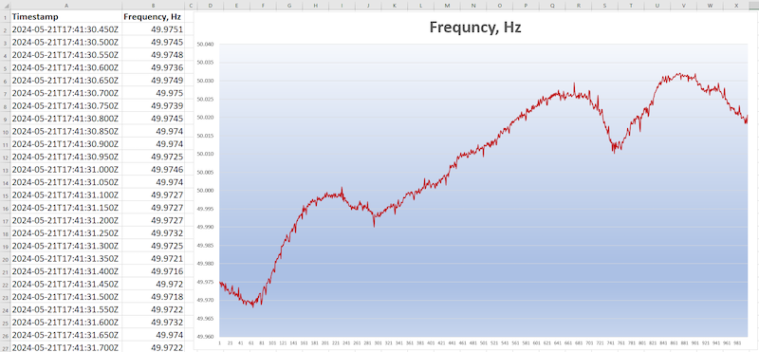
Dynamic Containment: Post-Event Frequency Response
National Grid (NESO) service requirements
Data polling every 50 ms
Continuous CSV recording (file per hour)
Secure API data transfer
Only fast meters combined with fast software can meet these requirements reliably

Slide 16
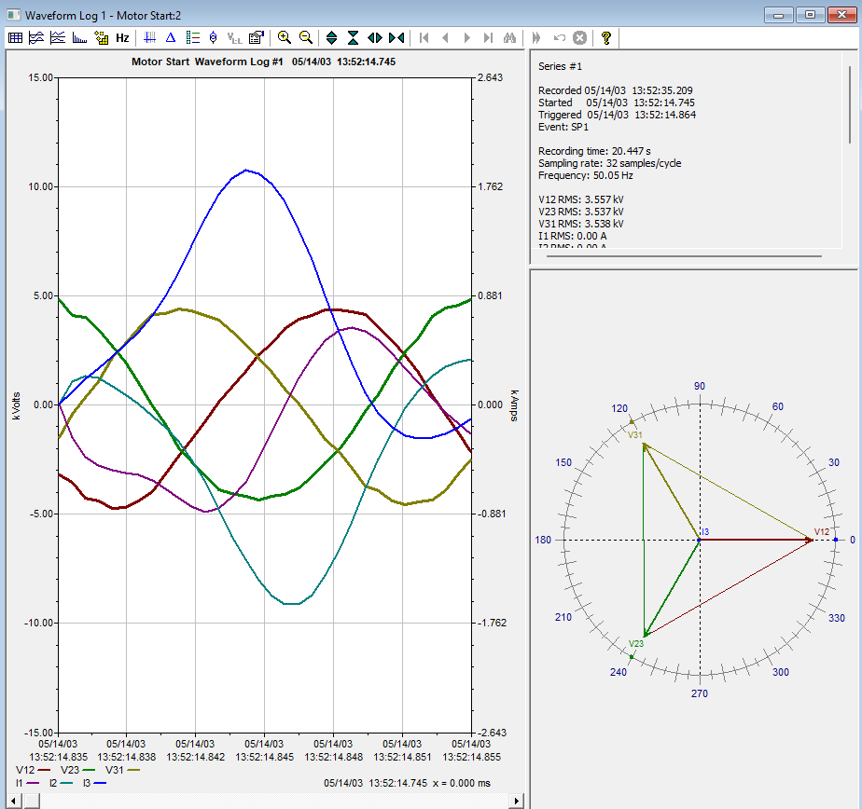

Continuous Data Log & Waveform Recording
SATEC meters:
Support waveform capture on trigger events
Sufficient for most applications
Some applications require:
Continuous waveform recording
Very frequent data logging

Slide 17
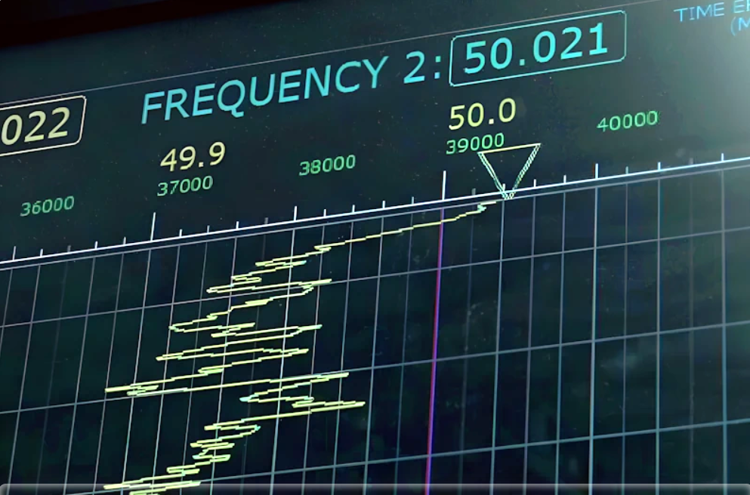
Continuous Data Log & Waveform Recording
RTR enables Real-time waveform recording
This closes the gap with:
More expensive meter brands (e.g. Elspec)
Projects previously specifying non-SATEC meters
RTR records frequent data logs without affecting meter memory lifetime

Slide 18
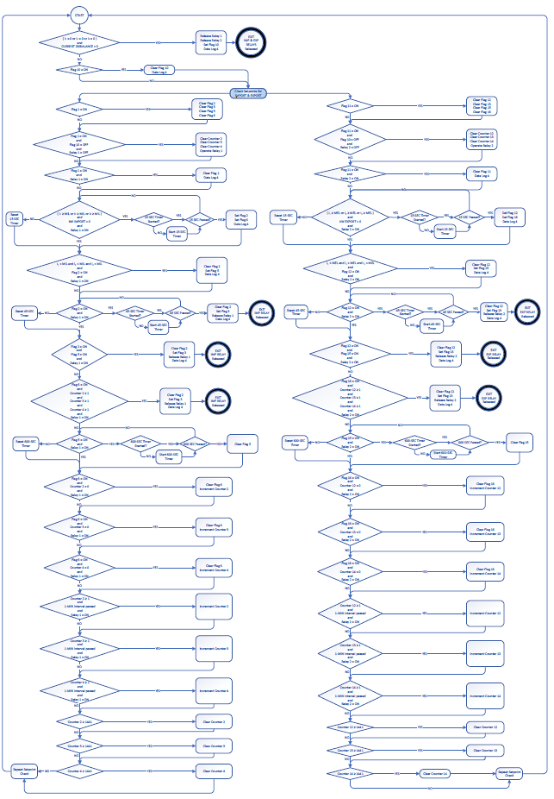
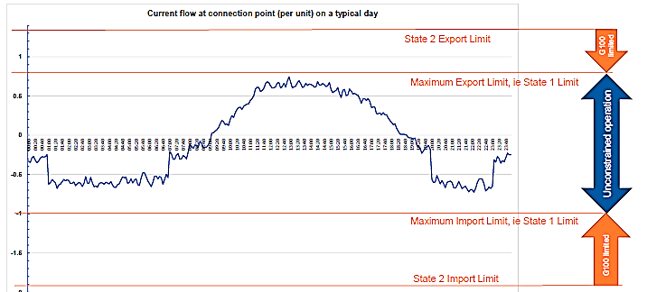
G100 Export / Import Limitation
Compliance with G100 Engineering Recommendation
Extensive use of PRO meter set points
PAS configuration:
Time-consuming.
Error-prone.
RTR-based solution simplifies the entire process

Slide 19
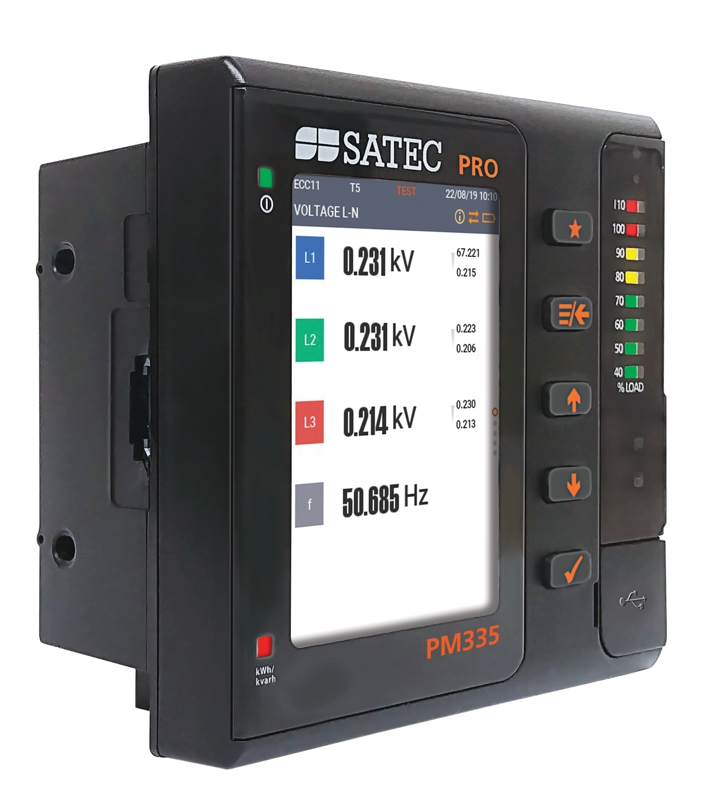
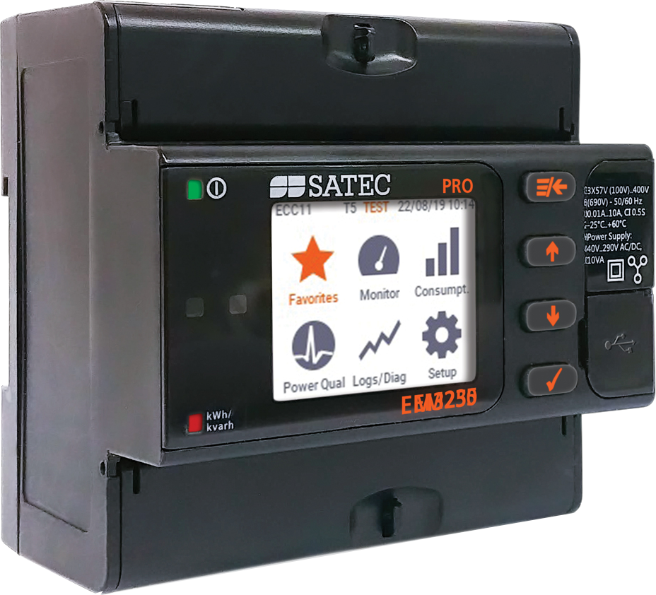
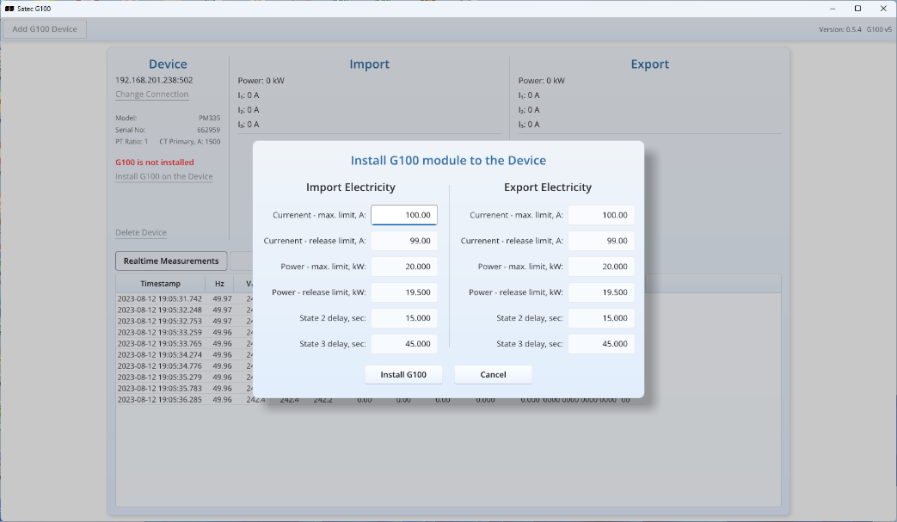

G100 GUI Capabilities (RTR-Based)
Set CT / PT ratios without PAS
Configure:
MIL – Maximum Import Limit
MEL – Maximum Export Limit
Configure time delays per DNO agreement
Upload configuration directly to the meter
Reading Data log to analyse G100 excursion events

Slide 20
G100 Security, Monitoring & Commissioning
G100 event monitoring
Testing & commissioning tools
Role-based access on the Software level (G100 compliant)
Password management
Reduced commissioning time and fewer errors

Slide 21
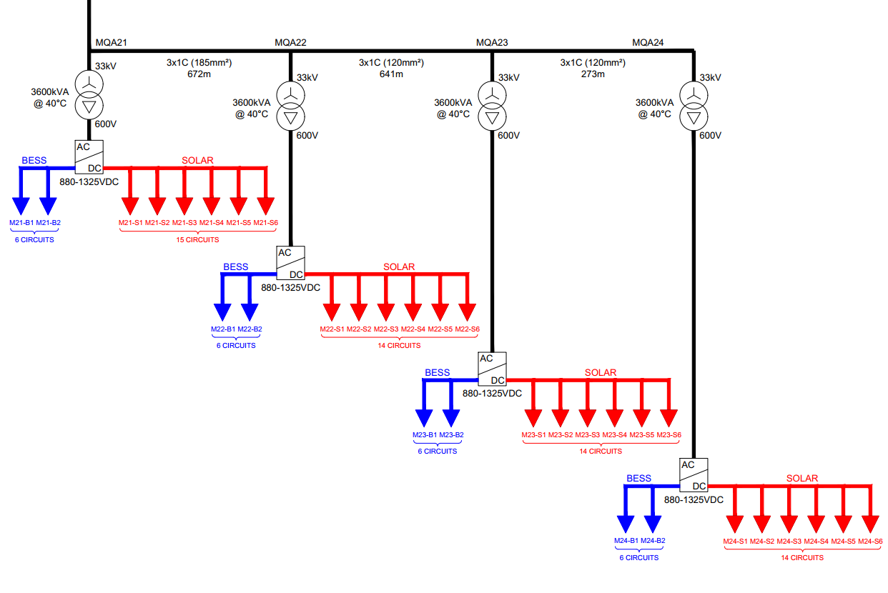
DC Metering Aggregation - PV / BESS
Inverter-level DC metering
Aggregation across multiple devices
Loss calculations based on data from multiple meters

Slide 22
What this means for SATEC agents?
Makes SATEC meters easier to specify in projects
Reduces objections from developers
Enables advanced grid services
Higher meter acceptance
More project wins
Strong technical differentiation
Result:

Slide 23
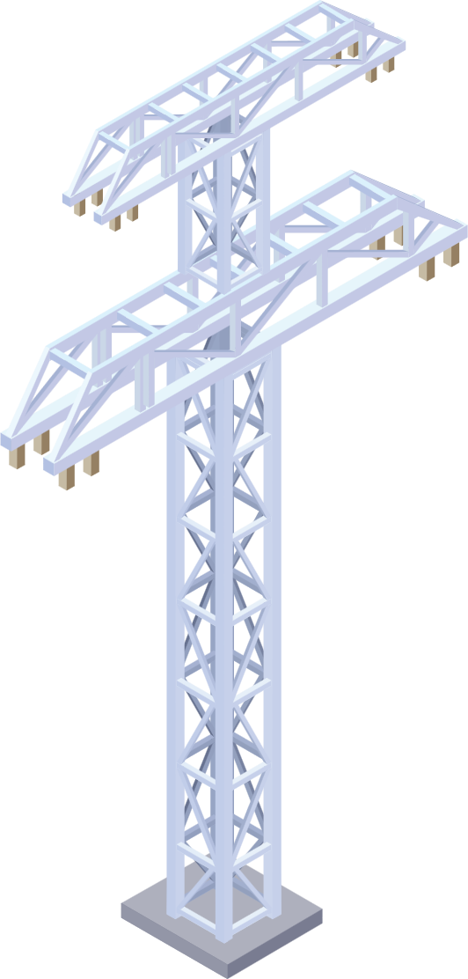






Typical Project Use Cases
Utility-scale PV plants
BESS & Hybrid systems
Frequency response services
EV charging stations
Grid compliance solutions
Embedded edge-metering applications
PPC
INVERTER
GRID
DC / DC
COUPLER
SUBSTATION
BESS
WIND
PV FIELD

Slide 24



Conclusion
RTR unlocks the full potential of SATEC meters
Designed for modern renewable energy projects
Proven, fast, and flexible
Learn more:
https://hitec-instruments.co.uk
+44 151 909 2333

Slide 25
Thank You!

